Slide 1
2.1-2.2 Data Size & Data Age
Data Enlarge
Step 1:
Select CustomerID, EmployeeID, OrderDate, RequiredDate, ShippedDate, ShipVia, Freight, ShipName, ShipAddress, ShipcCity, ShipRegion, ShipPostalCode, ShipCountry, CreditCard into orders_op from Orders where OrderID>0
Insert into [orders] (CustomerID, EmployeeID, OrderDate, RequiredDate, ShippedDate, ShipVia, Freight, ShipName, ShipAddress, ShipcCity, ShipRegion, ShipPostalCode, ShipCountry, CreditCard )—Run five times

Slide 2
2.1-2.2 Data Size & Data Age
Data Enlarge
Step 2:
UPDATE Orderdetailcp
SET OrderID = abs (checksum(NewID())% 666462)--Generate new columnID with random number--Run five times

Slide 3
2.2 Data Age
Update [Orders]
Set OrderDate= DATEADD(year, +20,OrderDate),
RequiredDate=DATEADD(year, +20, RequiredDate),
ShippedDate+DATEADD(year, +20, ShippedDate) where OrderID>111077

Slide 4
2.5Add Data Referencing
– add category Name in Order Details
Step 1: Add category ID in [Order details]
alter table [order details] add CategoryID char(50)
go
update [order details]
set CategoryID=Products.CategoryID
from [Order Details ]inner join Products on [Order Details].ProductID = Products.ProductID
go

Slide 5
Add Data Referencing
– add category Name in Order Details
Step 2: insert categoryName in [Products]
alter table [products] add CategoryName char(50)
go
update [products]
set CategoryName=Categories.CategoryName
from [Products]inner join Categories on [Products].CategoryID=Categories.CategoryID
go

Slide 6
Add Data Referencing
– add category Name in Order Details
Step 3: insert category name in [order details]
alter table [order details] add CategoryName char(50)
go
update [order details]
set CategoryName=Categories.CategoryName
from [Order Details]inner join Categories on [Order Details].CategoryID = Categories.CategoryID
go

Slide 7
Add Data Referencing
– add credit card information in Orders
Step 1: add credit card in [Customers]
alter table Customers
add Creditcard nvarchar(16)
go
UPDATE Customers
SET Creditcard = Left(abs(checksum(NewId()) % 899999999)+100000000,9) +RIGHT(abs(checksum(NewId()) % 8999999)+1000000,7)
go

Slide 8
Add Data Referencing
– add credit card information in Orders
Step 2: insert credit card in [Orders]
update Orders
set CreditCard= t.CreditCard
from Orders p inner join Customers t
on p.CustomerID = t.CustomerID
go

Slide 9
Add Data Referencing
– add total price in Orders
Step 1: add Sell Price in [order details]
alter table [Order Details]
add SellPrice money
go
update [Order Details]
set SellPrice= UnitPrice*Quantity*(1-Discount)
go

Slide 10
Add Data Referencing
– add total price in Orders
Step 2: Sum sell price and sored by OrderID
select OrderID, sum(SellPrice) 'TP' into Priceupdate
from [Order Details]
Group by OrderID
go

Slide 11
Add Data Referencing
– add total price in Orders
Step 3: add total price in [Orders]
update Orders
set TotalPrice= t.TP
from Orders p inner join Priceupdate t
on p.OrderID=t.OrderID
go

Slide 12
2.7 Introduce Ad-hoc Queries
DEMO OpenDataSource
OpenRowset
OpenQuery

Slide 13
What is OpenDataSource?
- It is one of the methods used to query a remote SQL server database and it is a T-SQL function.
- It provides an ad hoc connection information as part of a four-part object name without using a linked server name

Slide 14
Steps to Run OpenDataSource. 1st & 2nd step
There are 5 steps:
  - First, download the Microsoft Access 2010 Engine 2010 Redistributable from the
  Microsoft website to install the 64-bit Microsoft.ACE.OLEDB.12.0 driver on the 64-
  bit SQL server.
  - Secondly, since we are using a 64-bit SQL server so we download 64-bit
  Microsoft Office and remove the 32-bit Microsoft Office if it is already installed

Slide 15
Steps to run OpenDataSource – 3rd step
We configure the Ad Hoc Distributed queries using the code below:
sp_configure 'show advanced options', 1;
RECONFIGURE;
GO
sp_configure 'Ad Hoc Distributed Queries', 1;
RECONFIGURE;
GO

Slide 16
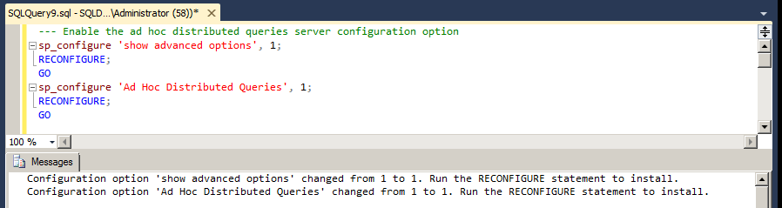
Steps to run OpenDataSource – 3rd step

Slide 17
Steps to run OpenDataSource – 4th step
Now, we need to configure the OLE DB properties using the code below:
EXEC sp_MSset_oledb_prop N'Microsoft.ACE.OLEDB.12.0', N'AllowInProcess', 1
GO
EXEC sp_MSset_oledb_prop N'Microsoft.ACE.OLEDB.12.0', N'DynamicParameters', 1
GO

Slide 18
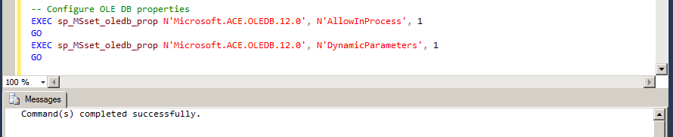
Steps to run OpenDataSource – 4th step

Slide 19
Steps to run OpenDataSource – 5th step
Lastly, we use the code below to run the OpenDataSource function:
SELECT * FROM OPENDATASOURCE('Microsoft.ACE.OLEDB.12.0',
'Data Source=C:\Users\Administrator\Desktop\excelsheet1.xlsx;Extended Properties=Excel 12.0')...[Sheet1$]

Slide 20
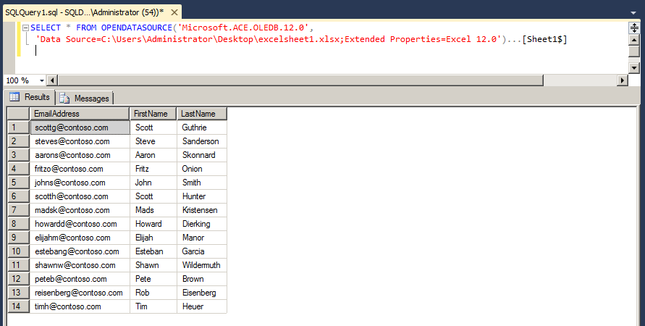
Steps to run OpenDataSource – 5th step

Slide 21
Syntax and Arguments for the OpenDataSource
Syntax:
OPENDATASOURCE (provider_name, init_string)
OpenDataSource:
provider_name
Is the name registered as the PROGID of the OLE DB provider used to access the data source. provider_name is a char data type, with no default value.
init_string
Is the connection string passed to the IDataInitialize interface of the destination provider. The provider string syntax is based on keyword-value pairs separated by semicolons, such as: 'keyword1=value ; keyword2=value'.

Slide 22
OPENROWSET (Transact-SQL)
OPENROWSET is a T-SQL function that allows for reading data from many
sources including using the SQL Server's BULK import capability.
Includes all connection information that is required to access remote data from an OLE DB data source. This method is an alternative to accessing tables in a linked server and is a one-time, ad hoc method of connecting and accessing remote data by using OLE DB.

Slide 23
Step 1 - Enables Ad Hoc Distributed Queries
sp_configure 'show advanced options', 1;
RECONFIGURE;
GO
sp_configure 'Ad Hoc Distributed Queries', 1; RECONFIGURE;
GO
Msg:
Configuration option 'show advanced options' changed from 1 to 1. Run the RECONFIGURE statement to install.
Configuration option 'Ad Hoc Distributed Queries' changed from 1 to 1. Run the RECONFIGURE statement to install.

Slide 24
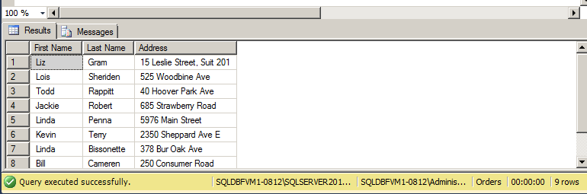
Step 2 – Using the “OPENROWSET” Function
Select * from openrowset
('Microsoft.ace.oledb.12.0','excel 12.0;
HDR=yes;index=1,
database=C:\Users\Administrator\Desktop\Test Data.xlsx',[sheet1$])

Slide 25
Troubleshoot - OLE DB Provider
Use Query： Select * from Sys.System_object
To see if it has Microsoft.ace.oledb.12.0 installed.
If not, simply download “Microsoft Access Database Engine 2010 Redistributable” from Microsoft Website.
Because we have 32-bit installed previously, we have to uninstall “Microsoft Office Enterprise 2007”, then install 64-bit.
Then run “OPENROWSET” Function.

Slide 26
Other Examples (explanation)
OPENROWSET
( { 'provider_name' , { 'datasource' ; 'user_id' ; 'password'
| 'provider_string' }
, { [ catalog. ] [ schema. ] object
| 'query'
}
| BULK 'data_file' ,
{ FORMATFILE = 'format_file_path' [ <bulk_options> ]
| SINGLE_BLOB | SINGLE_CLOB | SINGLE_NCLOB }
} )
<bulk_options> ::=
[ , CODEPAGE = { 'ACP' | 'OEM' | 'RAW' | 'code_page' } ]
[ , DATASOURCE = 'data_source_name' ]
[ , ERRORFILE = 'file_name' ]
[ , ERRORFILE_DATASOURCE = 'data_source_name' ]
[ , FIRSTROW = first_row ]
[ , LASTROW = last_row ]
[ , MAXERRORS = maximum_errors ]
[ , ROWS_PER_BATCH = rows_per_batch ]
[ , ORDER ( { column [ ASC | DESC ] } [ ,...n ] ) [ UNIQUE ] ]
-- bulk_options related to input file format
[ , FORMAT = 'CSV' ]
[ , FIELDQUOTE = 'quote_characters']
[ , FORMATFILE = 'format_file_path' ]

Slide 27
Other Examples (Explanation)
'provider_name'
Is a character string that represents the friendly name (or PROGID) of the OLE DB provider as specified in the registry. provider_name has no default value.
'datasource'
Is a string constant that corresponds to a particular OLE DB data source. datasource is the DBPROP_INIT_DATASOURCE property to be passed to the IDBProperties interface of the provider to initialize the provider. Typically, this string includes the name of the database file, the name of a database server, or a name that the provider understands to locate the database or databases.
'user_id'
Is a string constant that is the user name passed to the specified OLE DB provider. user_id specifies the security context for the connection and is passed in as the DBPROP_AUTH_USERID property to initialize the provider. user_id cannot be a Microsoft Windows login name.
'password'
Is a string constant that is the user password to be passed to the OLE DB provider. password is passed in as the DBPROP_AUTH_PASSWORD property when initializing the provider. passwordcannot be a Microsoft Windows password.
'provider_string'
Is a provider-specific connection string that is passed in as the DBPROP_INIT_PROVIDERSTRING property to initialize the OLE DB provider. provider_string typically encapsulates all the connection information required to initialize the provider. For a list of keywords that are recognized by the SQL Server Native Client OLE DB provider, see Initialization and Authorization Properties.
catalog
Is the name of the catalog or database in which the specified object resides.
schema
Is the name of the schema or object owner for the specified object.
object
Is the object name that uniquely identifies the object to work with.
'query'
Is a string constant sent to and executed by the provider. The local instance of SQL Server does not process this query, but processes query results returned by the provider, a pass-through query. Pass-through queries are useful when used on providers that do not make available their tabular data through table names, but only through a command language. Pass-through queries are supported on the remote server, as long as the query provider supports the OLE DB Command object and its mandatory interfaces.

Slide 28
What is AD-hoc Queries?
- AD-Hoc is a non-standard inquiry which created to obtain information as
need arises. AD-Hoc Openquery is a term of information technology.
AD-Hoc query or report is a significant topic of Business Intelligence.
It often relevant with OLAP, Datawarehouse, Datamining and other tools.

Slide 29
What is OpenQuery ?
- The OpenQuery command is used to initiate an ad-hoc distributed query using
a linked-server.
- It is initiated by specifying OpenQuery as the table name in the from clause.
Essentially, it opens a linked server, then executes a query as if executing from
that server.

Slide 30
What is OpenQuery ?
While executing queries directly and receiving data directly in this way is not bad,
there are implication when trying to join the results of OpenQuery with a local table.
Typically joining remote tables with local tables across the network is not the most efficient method of querying.
In some cases, it may be better to subscribe to a remote table by importing it locally, then joining it locally.

Slide 31
OpenQuery:
- First, set up Ad Hoc Distributed Queries. It need to be applied to the default configuration in order to allow “Ad Hoc Distributed Queries”.
- The next step is to find or define the link server required and specify the linkder
server name as the first parameter in OpenQuery.
- It need to set up linked server) OpenQuery is specified right after the from clause
followed by the first parameter as the linked server, and the second parameter
as the query to execute.

Slide 32
Examples:
OpenQuery 用法需要创建一个链接
首先，创建一个连接创建链接服务器
Exec sp_addlinkedserver ‘ITSV’, ‘’, ‘SQL0LEDB’ ,’ 远程服务器名或IP地址‘
---查询
Select *
FROM OpenQuery（ITSV，’SELECT * FROM 数据库. dbo . 表名‘
---把本地表导入远程表
Insert openquery(ITSV, ‘ SELECT * FROM 数据库. Dbo. 表名’）
Select * from 本地表

Slide 33
Examples：
--- 如何更新本地表
Update b
Set b. 列B=a. 列B
FROM openquery（ITSV, ‘SELECT * FROM 数据库. dbo . 表名’） as a inner join 本地表
b on a. 列A=b . 列A
Openquery using OLEDB
exec sp_addlinkedserver ‘ITSV’, ’’, ‘SQLOLEDB ‘,’ (local)
Exec sp_addlinkedsrvlogin ‘ITSV’, ‘false’, null, ‘sa’, ‘***’
Select * FROM openquery(ITSV, ‘SELECT * FROM TB.dbo.school ‘

Slide 34
Examples:
Openquery using SQLNCLI
Exec sp_addlinkedserver ‘ITSVA’ , ‘ ‘ , ‘ SQLNCLI ‘,’ (local)’
Exec sp_addlinkedsrvlogin ‘ITSVA’, ‘false’, null, ‘sa’, ‘***’
Select * FROM openquery (ITSVA, ‘SELECT * FROM TB. dbo. School’)
Others
Insert openquery(ITSVA, ‘SELECT name from TB. Dba. School where id=1’）values(‘ghjkl）
update openquery(ITSVA,'select name from TB.dbo.school where id=1') set name='kkkkkk'
delete openquery(ITSVA,'select name from TB.dbo.school where id=1')

Slide 35
2.8 Managing Ad-Hoc Queries
Because the variables can not directly pass into the Openrowset function, we need to build the dynamic queries to finish the steps:
create procedure ope_nrowset @t nvarchar(300)= 'Microsoft.ACE.OLEDB.12.0',@t2 nvarchar(300)='Excel 12.0;HDR=Yes;IMEX=1;',
@t3 nvarchar(3000)= 'Database=C:\test.xlsx', @t4 nvarchar(3000)='[sheet1$]'
as
declare @sql nvarchar(3000)
set @sql= 'select' + '*' + 'from' + ' ' + 'OpenRowSet' + '(' + '''' + @t + '''' + ','
+ '''' + @t2 + @t3 +'''' + ',' + @t4 + ')'
print @sql
exec (@sql)
go
exec ope_nrowset
drop procedure ope_nrowset

Slide 36
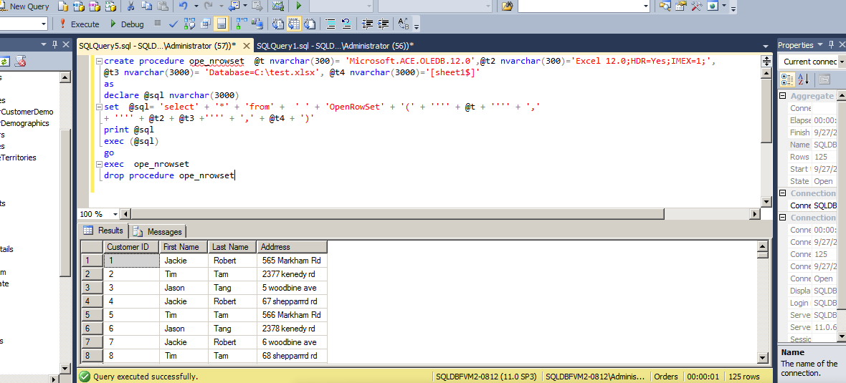
The results shows like:

Slide 37
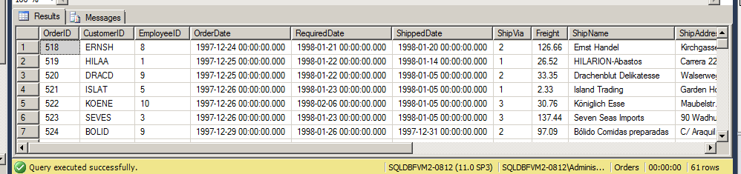
2.9 Key Performance Indicator
To better demonstrate this chapter, we create a table KPItest

Slide 38
Here is the Scrip:
select EmployeeID, Sum(Totalsales) 'Annual Sales 1997' into #tempt1 from KPItest
where orderdate between '1997-01-01' and '1997-12-31'
Group by EmployeeID
go
select EmployeeID, Sum(Totalsales) 'Annual Sales 1998' into #tempt2 from KPItest
where orderdate between '1998-01-01' and '1998-12-31'
Group by EmployeeID
go

Slide 39
Continue:
select distinct EmployeeID into #tempt3 from KPItest
alter table #tempt3
add [Annual Sales 1997] float, [Annual Sales 1998] float, Growth float
go
update #tempt3
set [Annual Sales 1997] = b.[Annual Sales 1997]
from #tempt3 a inner join #tempt1 b
on a.EmployeeID = b.EmployeeID
go

Slide 40
Continue:
update #tempt3
set [Annual Sales 1998] = b.[Annual Sales 1998]
from #tempt3 a inner join #tempt2 b
on a.EmployeeID = b.EmployeeID
go
update #tempt3
set Growth=Convert(decimal(20,2),([Annual Sales 1998]-[Annual Sales 1997])/[Annual Sales 1997])
select*from #tempt3

Slide 41
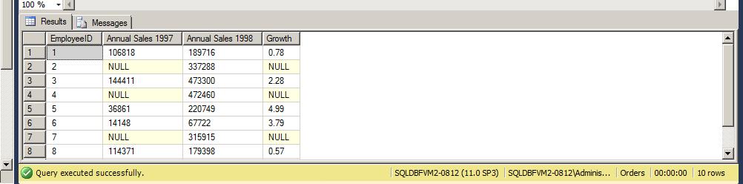
Result:

